Slide 1

Title: "Data Harmonization and Insights Extraction Project"
Subtitle: "Leveraging advanced data wrangling techniques to prepare a clean, unified dataset for business analysis and modeling“
Name: Ms.Irshad Shaikh-Junior Data Scientist
Submission Date:14/01/2025

Slide 2
Introduction
Problem Statement: "The project aims to address ambiguities and inconsistencies
in multiple datasets by employing advanced data wrangling techniques
to create a unified, clean dataset.“
Objective: "To enable future business analysis and modeling through data harmonization
and insights extraction.“
Deliverables:
Merged dataset.
Insights and analysis-ready data.

Slide 3
Datasets Used
Dataset_1:
Key Attributes:
instant: Unique identifier for each record.
date: Date of observation.
temp: Normalized temperature value, representing the average temperature in Celsius.
Description: Dataset_1 captures the time dimension and temperature data,
providing a foundation for trend analysis over time.
Dataset_2:
Key Attributes:
holiday: Indicates if the day was a public holiday (1 for yes, 0 for no).
working_day: Denotes if the day was a working day (non-weekend and non-holiday).
weather: Encodes weather conditions (e.g., clear, cloudy, rainy).
Description: Dataset_2 captures day-specific characteristics like holiday status, working status,
and weather, which are crucial for understanding daily variations in bike rentals.
Dataset_3:
Key Attributes:
registered: Number of registered users.
count: Total bike rentals (casual + registered).
casual: Number of casual (non-registered) uses.
Description: Dataset_3 provides the target variable (count) for analysis and separates rentals into casual
and registered users to identify usage patterns.

Slide 4
Project Workflow
Workflow Breakdown:
Phase 1: Data Acquisition:
Loading datasets into Python.
Initial exploration using .info() and .head().
Phase 2: Data Wrangling:
Merging datasets.
Handling missing values and duplicates.
Outlier detection.
Phase 3: Data Analysis:
Statistical analysis and skewness correction.
Visualizations (e.g., heatmaps, scatter plots).

Slide 5
Data Wrangling and Cleaning
Merged Dataset_1 and Dataset_2
Concatenated Dataset_3 after handling missing values.
Normalized numerical columns (temp, humidity, etc.)
Removed outliers using statistical thresholds (e.g., IQR method).
Key Steps Taken:
Merged Dataset_1 and Dataset_2 using instant as a common key.
Concatenated Dataset_3 after handling missing values.
Normalized numerical columns (temp, humidity, etc.)
Removed outliers using statistical thresholds (e.g., IQR method).

Slide 6
Exploratory Data Analysis (EDA)
Key Insights:
Correlations between temp and count.
Patterns in season and registered users.
Effect of holiday on total rentals.
Visualizations:
Violin plot: Humidity vs. Rentals.
Bar plot: Average rentals by season.
Heatmap: Correlation matrix.

Slide 7
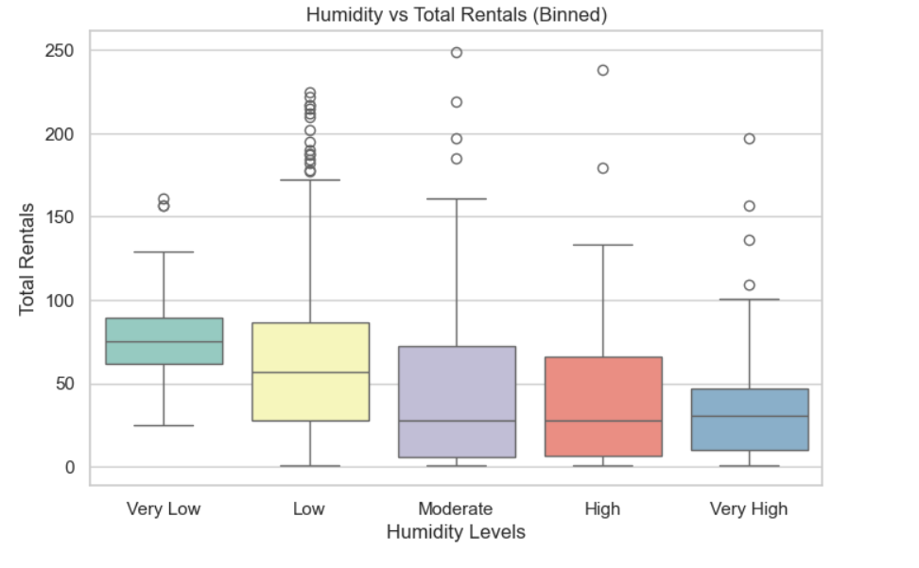

Slide 8
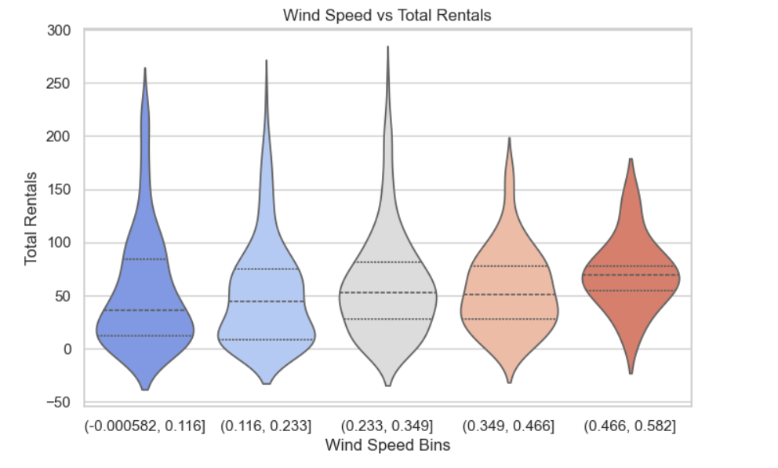

Slide 9
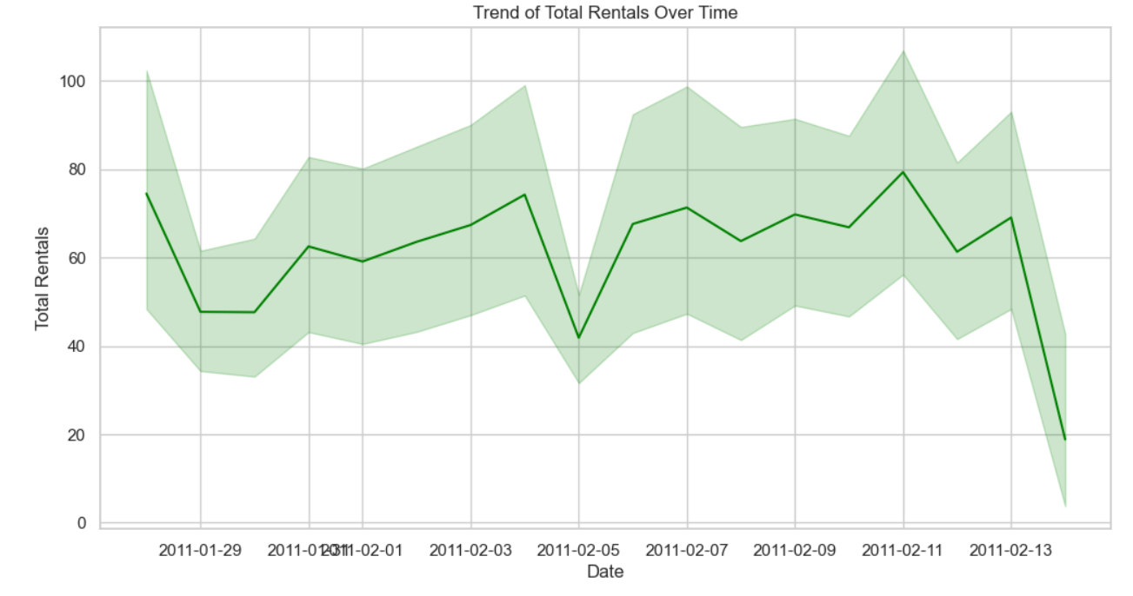

Slide 10
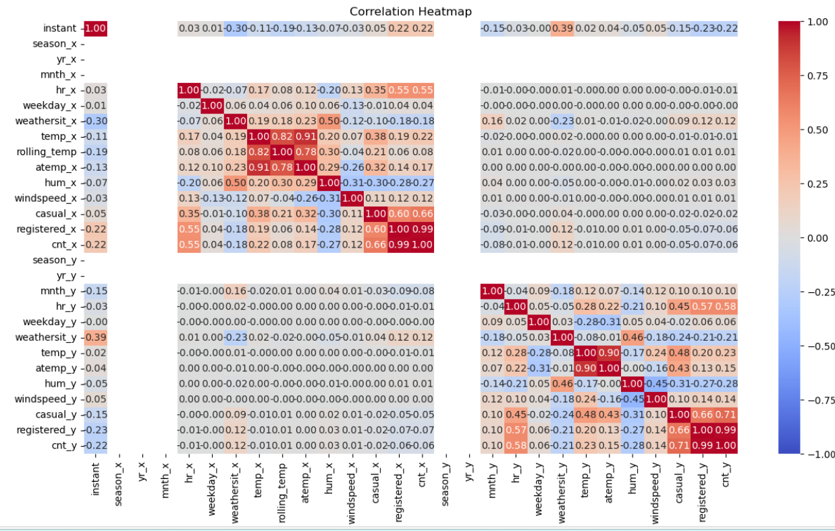

Slide 11
Results and Insights
Key Findings:
"Rentals peak during summer (Season 3)."
"Weekends and holidays have lower registered user counts."
"Humidity negatively correlates with count.“
Recommendations:
Use insights for demand forecasting.
Focus marketing efforts during peak seasons.

Slide 12
Challenges and Limitations.
Challenges:
Handling missing data in holiday.
Outlier detection and correction.
Ensuring consistency during dataset merging.
Limitations:
Weather data granularity (e.g., hourly variations missing).
Limited data sources for external validation.

Slide 13
Conclusion and Future Scope.
Summary:
Data harmonization enabled accurate, unified insights.
The project laid a foundation for future predictive modeling.
Future Scope:
Explore advanced machine learning models for forecasting.
Incorporate real-time weather data for enhanced predictions.

Slide 14
References
Sources:
Dataset URLs (Dataset1,Dataset2,Dataset3)
Libraries: Pandas, NumPy, Seaborn, Matplotlib.
Links or citations.
https://www.geeksforgeeks.org/data-wrangling-in-python/
https://seaborn.pydata.org/index.html
https://stackoverflow.com

Slide 15



